Slide 1

EIGENVALUES AND EIGENVECTORS
FACULTY IN-CHARGE:
Rahul R
SUBMITTED BY:
Khushi Agrawal
Vignesh JR
Lekha G Patel
Kashish Agarwal

Slide 2

CONTENTS
Introduction To Eigenvalues & Eigenvectors
Characteristic Equation
Graphical Interpretation of Eigenvalues & vectors
Properties of Eigenvalues
Cayley-Hamilton Theorem
Real Life Examples
Applications of Eigenvectors and Eigenvalues
Application on Basic Circuit (LR circuit)
Spectral Clustering
Conclusion
Bibliography

Slide 3
Introduction
The German prefix “eigen” translates to “self” or “own”. An eigenvector of A is a vector that is taken to a multiple of itself by the matrix transformation T(x)=Ax, which explains the terminology. On the other hand, “eigen” is also translated as “characteristic”; we may think of an eigenvector as describing a characteristic property of A.
Definition:
A vector which undergoes only scaling with no rotation, then the vector is called Eigenvector and the scaling factor is called Eigenvalue.
If X transforms to scalar multiple of itself, i.e., (AX=λX) where X ≠ 0, then X is called the Eigenvector and λ is called Eigenvalue.
Set of all eigenvectors defines eigenspace.

Slide 4
Introduction
NOTE:
Eigenvalues and eigenvectors are only for square matrices as we have to deal with determinants and determinants can be found only for square matrices.
Eigenvectors are by definition nonzero. Eigenvalues may be equal to zero.
We do not consider the zero vector to be an eigenvector: since A0=0=λ0 for every scalar λ, the associated eigenvalue would be undefined.
Eigenvalues can be positive, negative, zero or even complex.
Complex eigenvalues shows that the vectors have been rotated exactly by 90°, which gives us
complex eigenvalues.

Slide 5
Introduction
Eigenvalues and eigenvectors play a very important role in day to day life. Let us take the example of Tacoma Narrows Bridge collapse. The bridge collapsed after 4 months of its construction. This was because of the physics concept of Resonance. The natural frequency of the bridge which was supposed to be unique, matched the frequency of the blowing winds which led to the collapse.
Eigenvalues come to use here, the natural frequency of the bridge can be characterized by eigenvalue of smallest magnitude, so that it is not matched with other frequencies.
Hence, eigenvalues are heavily relied upon by engineers when it comes to construction.

Slide 6
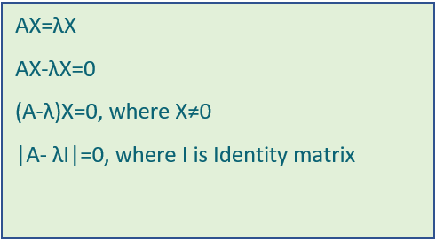
Characteristic Equation

Slide 7
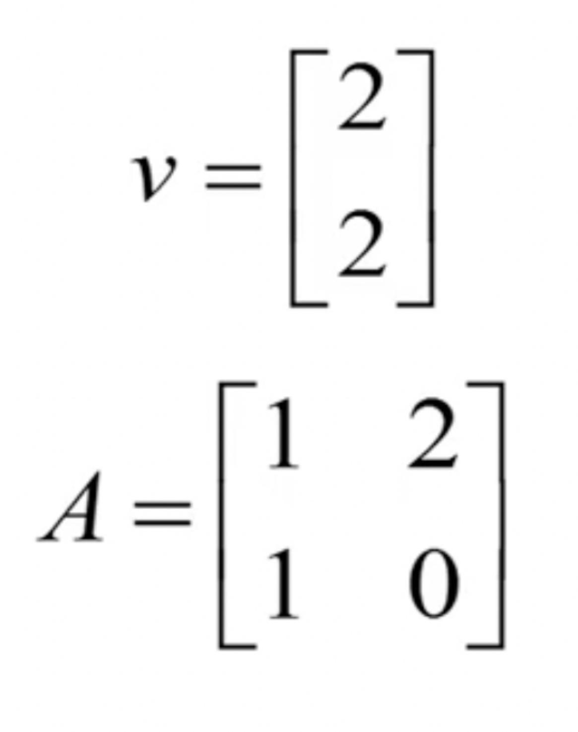
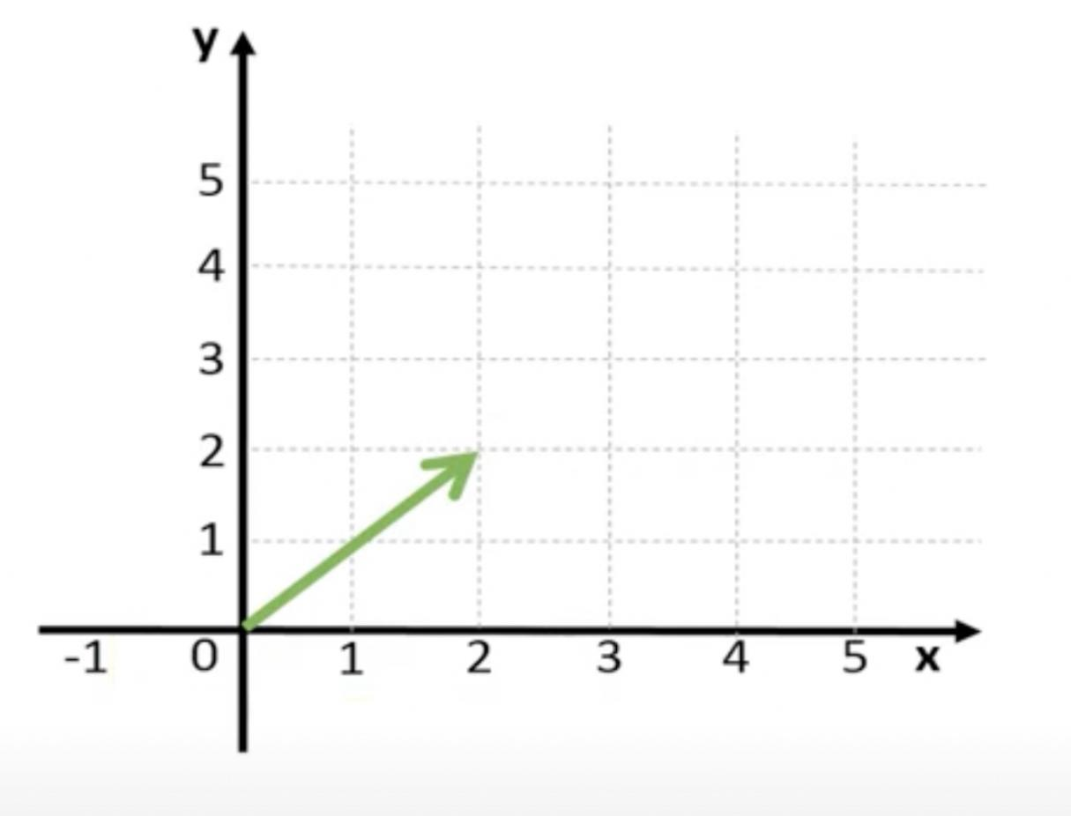
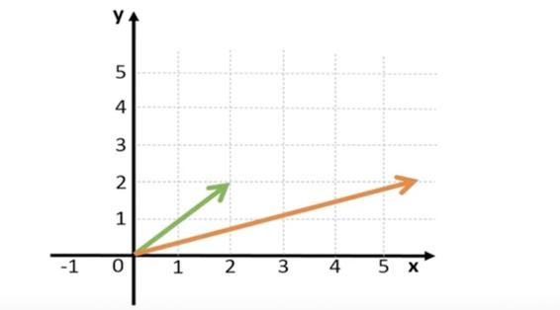
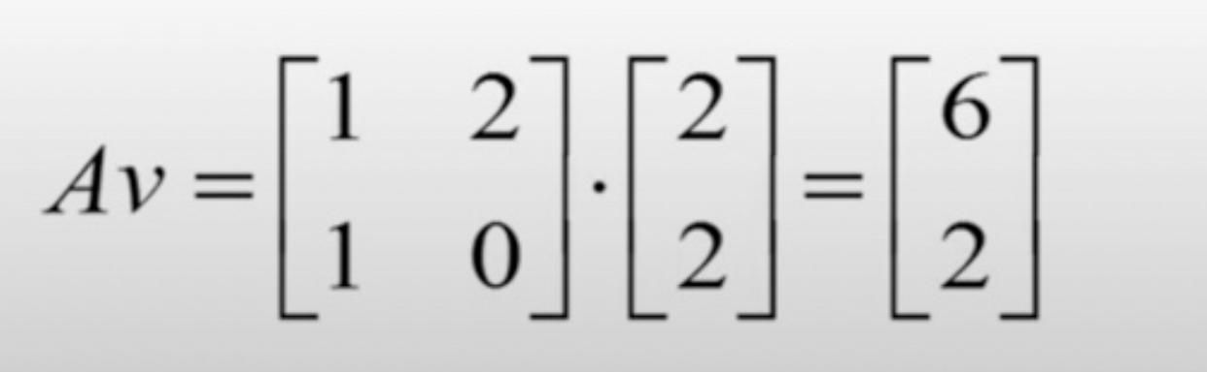
GRAPHICAL INTERPRETATION OF EIGENVALUES & VECTORS
As discussed in the previous slide, non-zero vector satisfying equation (AX=λX) where X ≠ 0 is an Eigenvector.

Slide 8
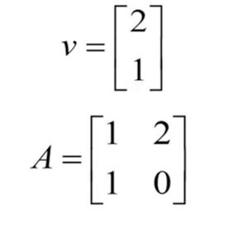
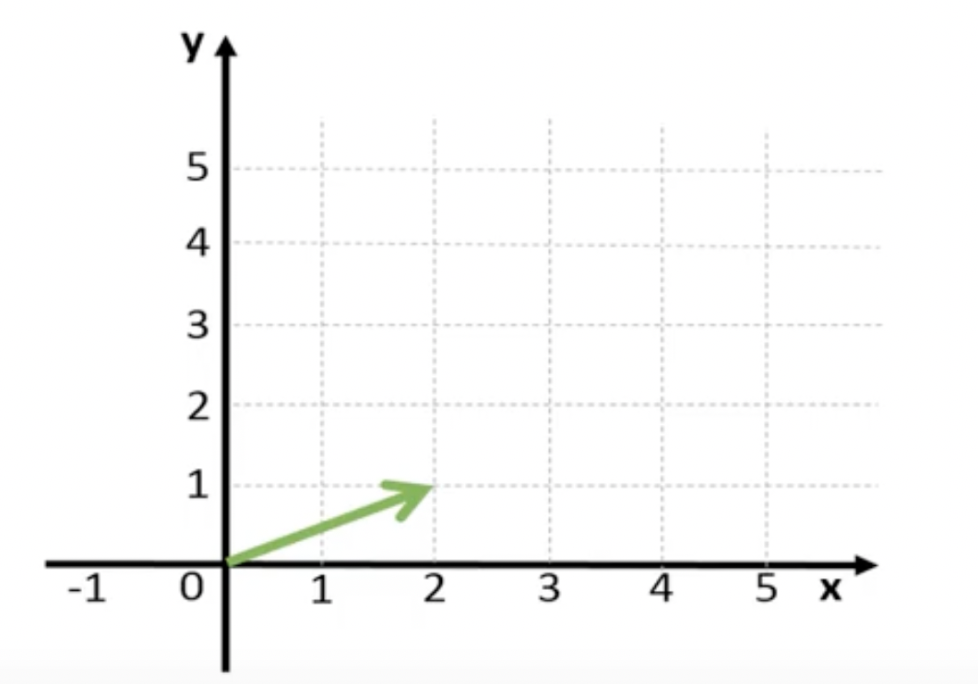
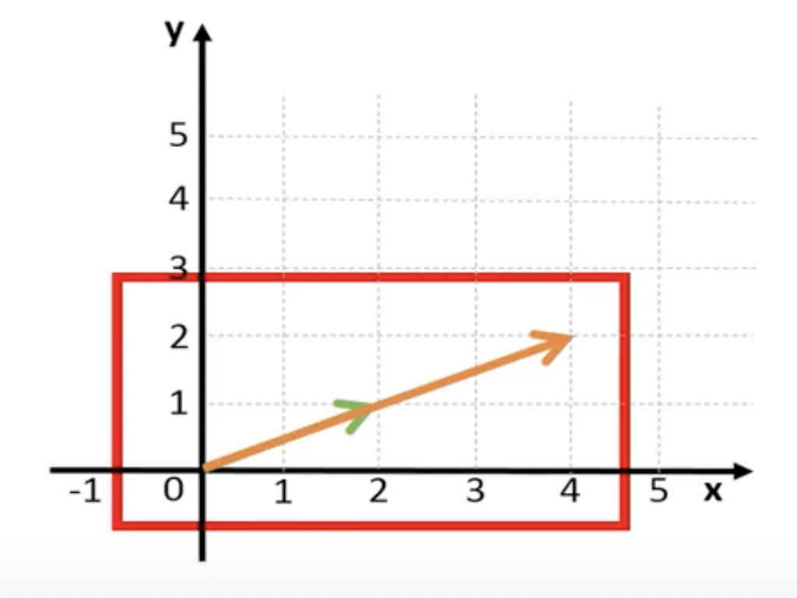
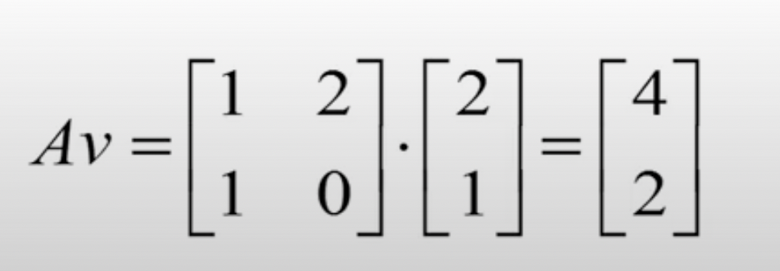
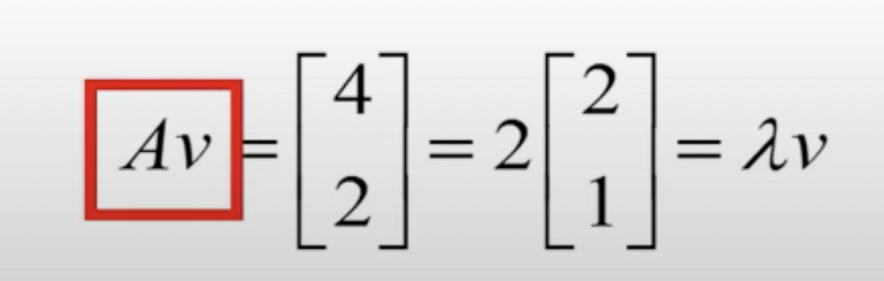
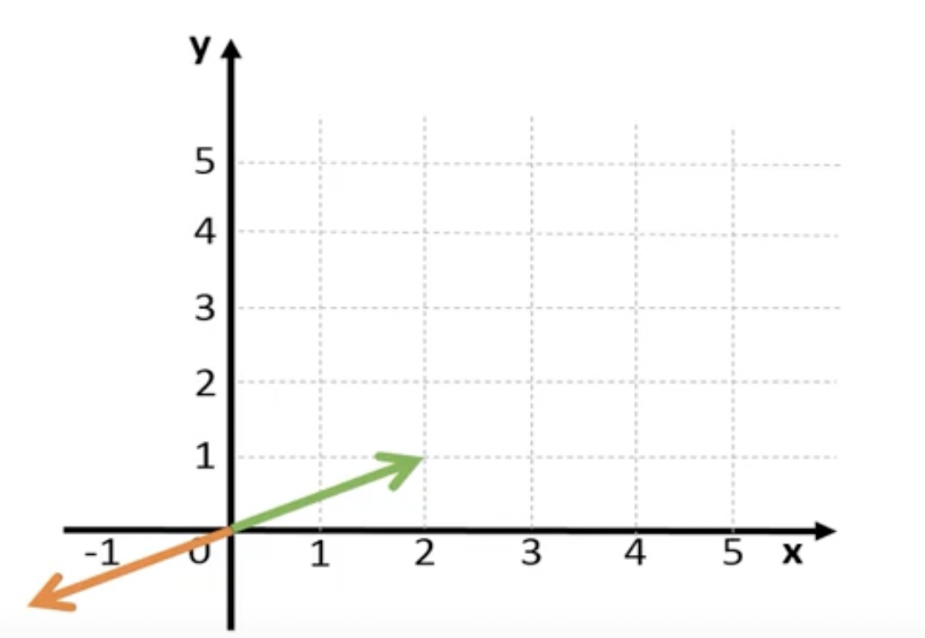
.
The eigenvalue tell us how much the eigenvector changes in size when multiplied with the matrix.
The eigen value can be negative,which means only the direction is reversed but still on the same ‘line’.

Slide 9
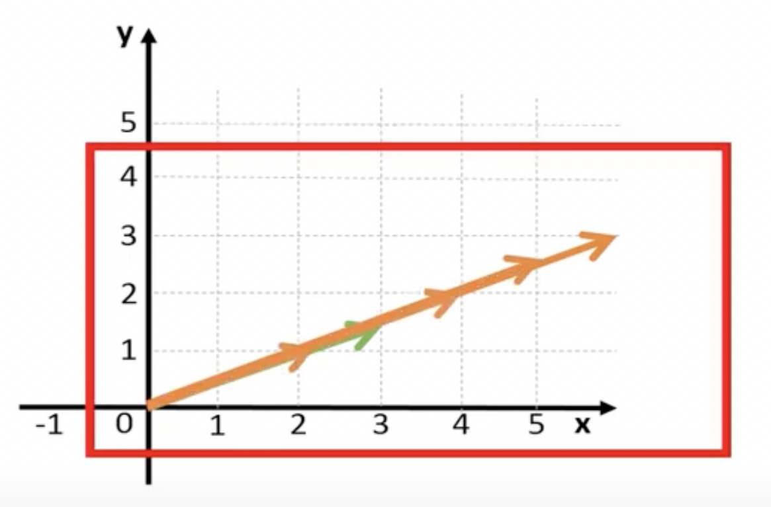
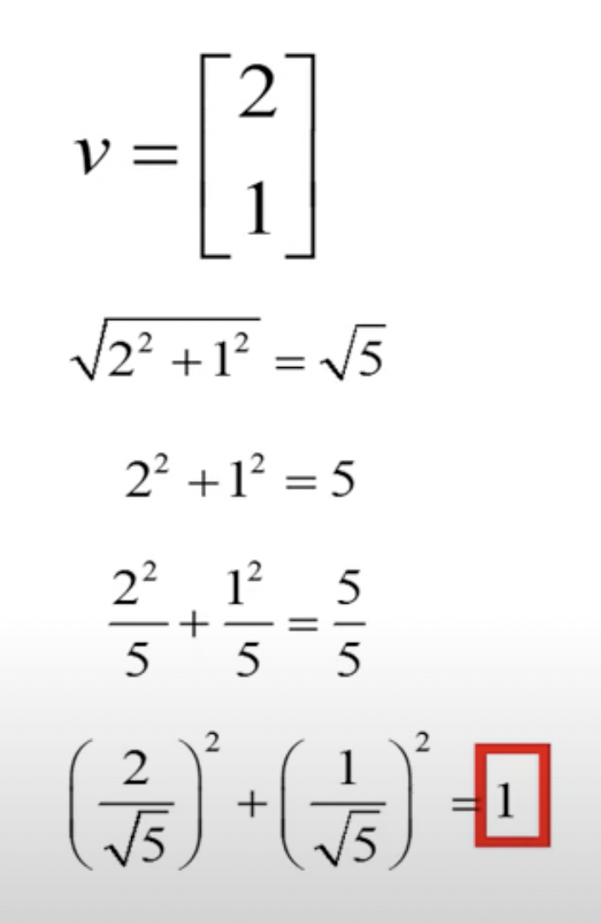
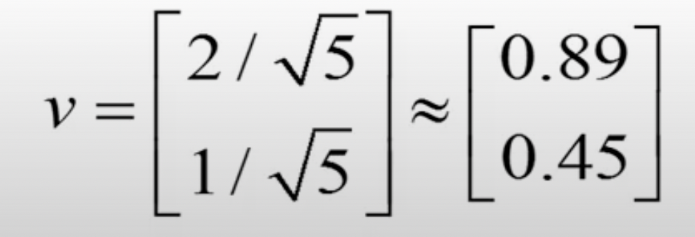
NOTE: We can find many eigenvectors for the matrix A. All vectors with the same direction are actually eigenvectors of matrix A.
Normalise Eigenvectors :
Taking any vector and reducing its magnitude to 1.0 while keeping its direction is called normalization.
Normalization is performed by dividing the x and y (and z in 3D) components of a vector by its magnitude.
Eigen vector of unit length
.

Slide 10
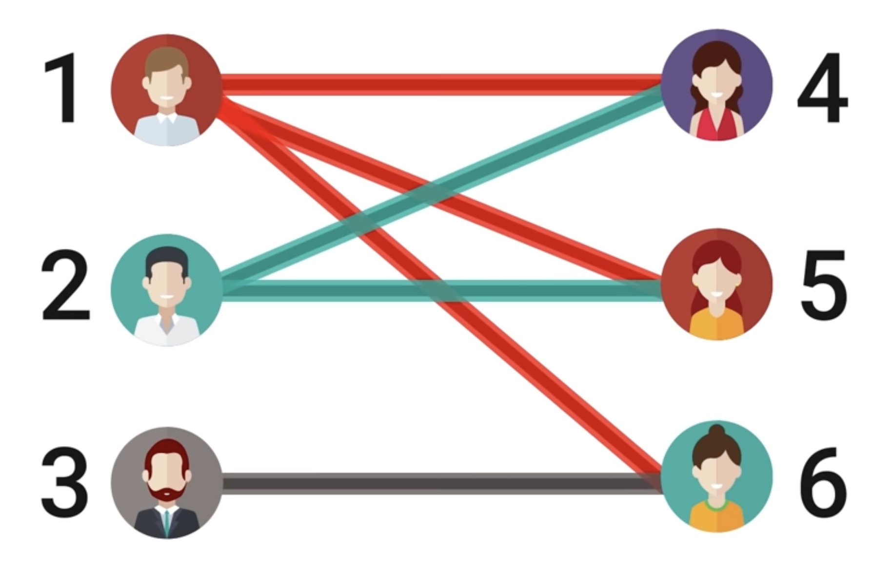
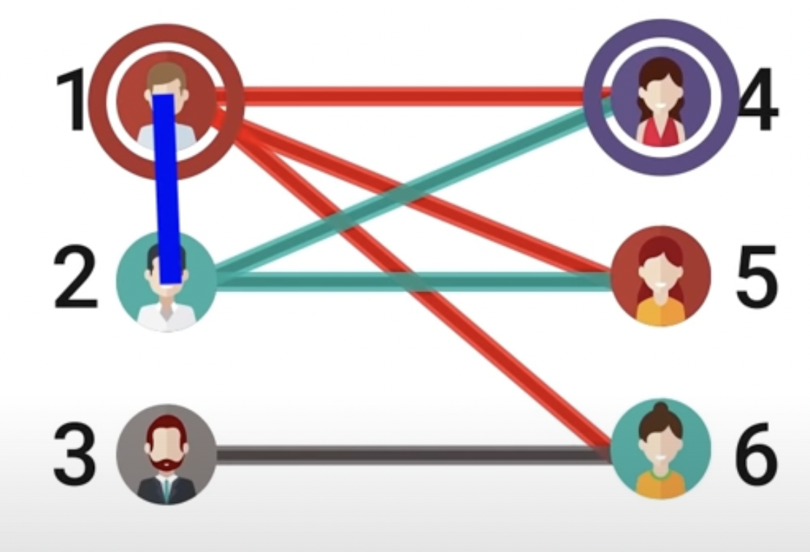
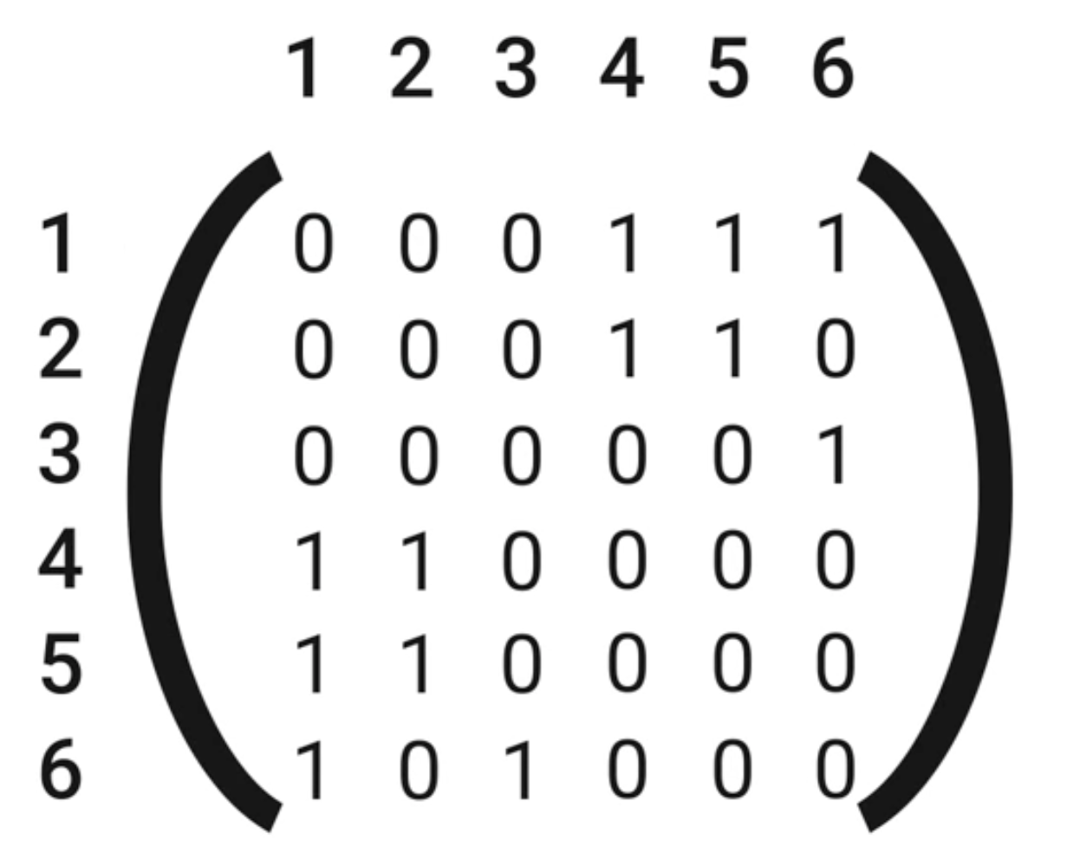
Bipartite
NOT A Bipartite
Eigenvalues
Conclusion: If G is bipartite, and λ is an eigenvalue of adjacency matrix A, then so is −λ.

Slide 11
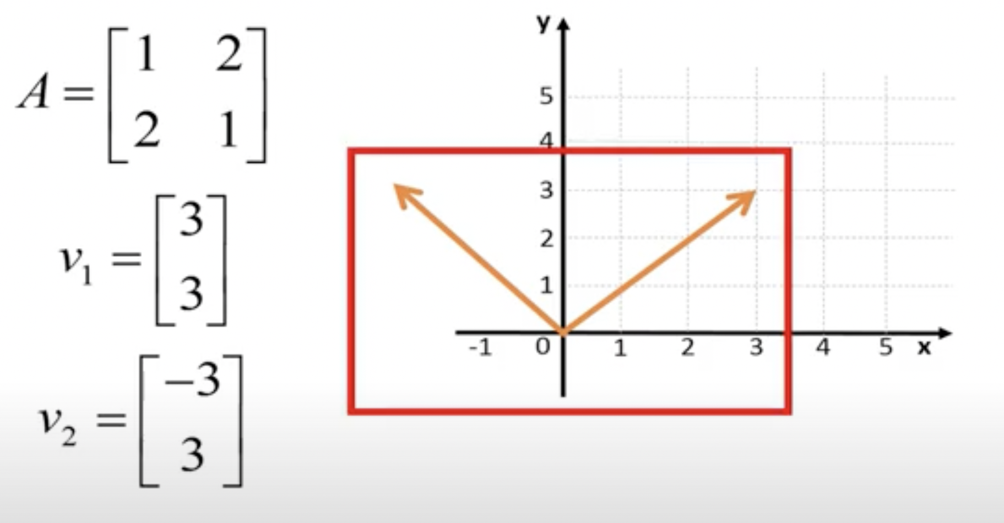
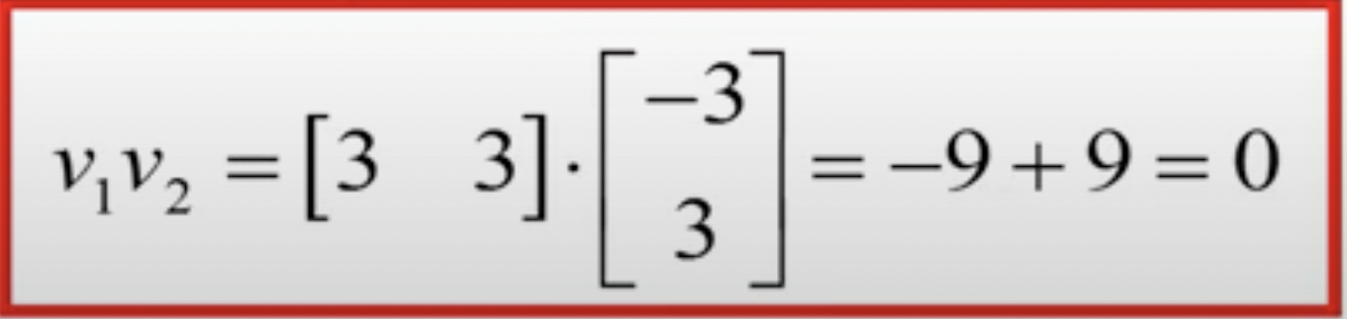
For a symmetric matrix like,
Also, scalar product of their eigenvectors should then be equal to zero.
Thus, two eigenvectors for a symmetric matrix will be orthogonal.

Slide 12
PROPERTIES OF EIGENVALUES
Property 1:
The sum of the Eigenvalues of a matrix is equal to the trace of the matrix.
Property 2:
A square matrix A and its transpose 𝐀𝐓 have the same Eigenvalues (characteristic values).
Property 3:
If λ is an eigenvalue of matrix A, then 1/λ is an eigenvalue of A−1.
Property 4:
The product of the eigenvalues of a matrix is equal to its determinant.
Property 5:
If λ is an eigenvalue of an orthogonal matrix, then 1/λ is also its eigenvalue.

Slide 13
.
CAYLEY-HAMILTON THEOREM
This theorem (named after the mathematicians Arthur Cayley and William Rowan Hamilton) states that every square matrix satisfies its own characteristic equation.
If A is an n x n matrix and I is the n x n identity matrix, then characteristic polynomial is defined as:
p(λ)=det(λI - A) then,
Cayley-Hamilton theorem states that substituting the matrix A for λ in this polynomial results in the zero matrix :-
p(A)=0.
CAYLEY-HAMILTON THEOREM is useful to find :
Inverse & power of matrix
Matrices are used in many fields like robotics, automation, encryption, quantum mechanics, etc. All places we would require powers of the matrix or it’s inverse.
It helps in expressing the inverse as a polynomial expression of the matrix. Higher powers of the matrix in terms of lower powers of the matrix.
The CAYLEY-HAMILTON THEOREM and its generalisations have been used in the control systems, electrical circuits, system with delays, singular systems specially in DC circuits.

Slide 14



REAL LIFE EXAMPLES
AV=wV

Slide 15

APPLICATIONS OF EIGENVECTORS AND EIGENVALUES
Communication systems:
Eigenvalues were used by Claude Shannon to determine the theoretical limit to how much information can be transmitted through a communication medium like your telephone line or through the air.
This is done by calculating the eigenvectors and eigenvalues of the communication channel (expressed a matrix), and then waterfilling on the eigenvalues. The eigenvalues are then, in essence, the gains of the fundamental modes of the channel, which themselves are captured by the eigenvectors.

Slide 16



Designing bridges:
Designing car stereo system:
The natural frequency of the bridge is the eigenvalue of smallest magnitude of a system that models the bridge. The engineers exploit this knowledge to ensure the stability of their constructions.
Eigenvalue analysis is also used in the design of the car stereo systems, where it helps to reproduce the vibration of the car due to the music.
Electrical Engineering:
Mechanical Engineering:
The application of eigenvalues and eigenvectors is useful for decoupling three-phase systems through symmetrical component transformation.
Eigenvalues and eigenvectors allow us to "reduce" a linear operation to separate, simpler, problems. For example, if a stress is applied to a "plastic" solid, the deformation can be dissected into "principal directions"- those directions in which the deformation is greatest. Vectors in the principle directions are the eigenvectors and the percentage deformation in each principle direction is the corresponding eigenvalue.

Slide 17

Oil companies frequently use eigenvalue analysis to explore land for oil.
Oil, dirt, and other substances all give rise to linear systems which have different eigenvalues, so eigenvalue analysis can give a good indication of where oil reserves are located. Oil companies place probes around a site to pick up the waves that result from a huge truck used to vibrate the ground. The waves are changed as they pass through the different substances in the ground. The analysis of these waves directs the oil companies to possible drilling sites.

Slide 18
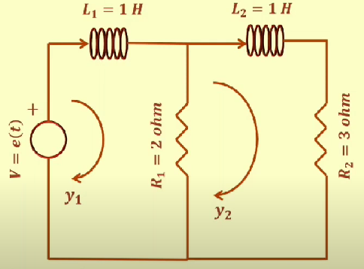

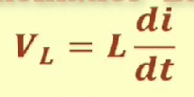
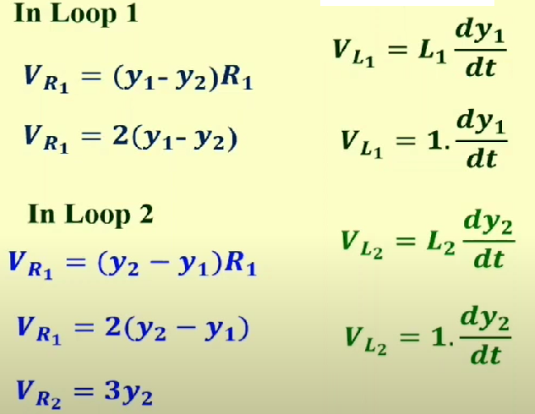
APPLICATION ON BASIC CIRCUIT
(LR CIRCUIT)
Consider a parallel inductor-resistor circuit
We know that

Slide 19
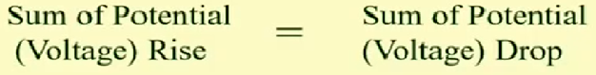
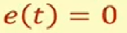
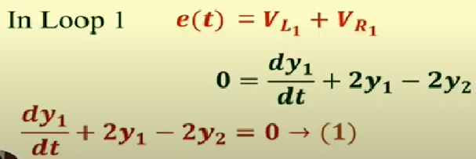
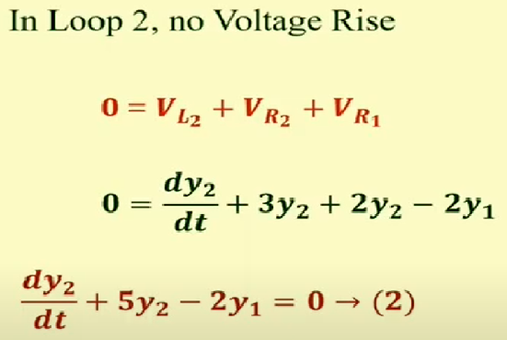
By Kirchhoff’s Voltage Law in any closed path
Assume the equations governing its operation with
By using ODE method to solve the equations

Slide 20
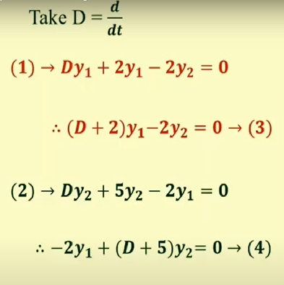
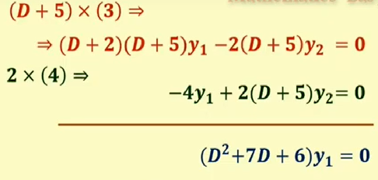
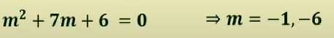

Using Auxiliary equation
Take the equations (3) and (4)

Slide 21
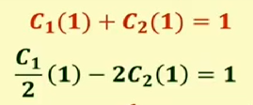
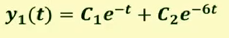
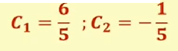
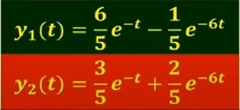
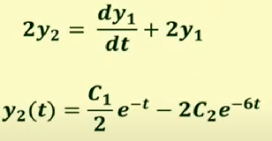
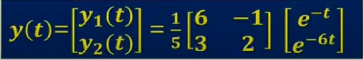

Solution (current flows in loops)of this differential equation
Real and distinct roots
We get
Using equation (1)

Slide 22
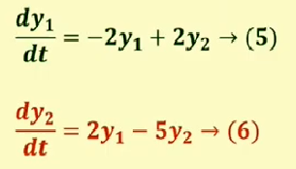
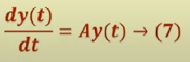
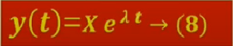
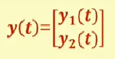
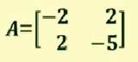
Same current values y(t) can be obtained by using eigenvalues and eigenvectors
Rewrite the equations (1) and (2) for transforming into Matrix form
Now we solve the equation (7) with Square matrix A
From the previous method
The solution may be assumed in the form
From (5) and (6)

Slide 23
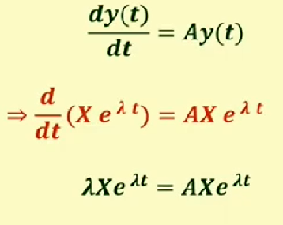
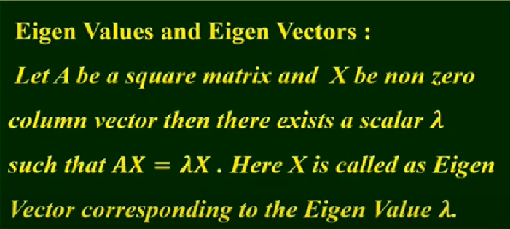

Substitute eq(8) in eq(7)

Slide 24
SPECTRAL CLUSTERING
Spectral Clustering is one of the main applications of eigenvalues and eigenvectors
Spectral clustering is a technique with roots in graph theory, where the approach is used to identify communities of nodes in a graph based on the edges connecting them. The method is flexible and allows us to cluster non graph data as well.
Spectral clustering uses information from the eigenvalues (spectrum) of special matrices built from the graph or the data set.

Slide 25
SPECTRAL CLUSTERING
To know About Spectral clustering , we need to know to first know about graphs.
Graphs are a natural way to represent many types of data. A graph is a set of nodes with a corresponding set of edges which connect the nodes. The edges may be directed or undirected and can even have weights associated with them.
The weights on the edges could represent the bandwidth available along that edge.

Slide 26
SPECTRAL CLUSTERING
Basic Terminologies Used in Spectral Clustering-
Adjacency and Affinity Matrix (A)
The graph (or set of data points) can be represented as an Adjacency Matrix, where the row and column indices represent the nodes, and the entries represent the absence or presence of an edge between the nodes (i.e. if the entry in row 0 and column 1 is 1, it would indicate that node 0 is connected to node 1).
Degree Matrix (D)
A Degree Matrix is a diagonal matrix, where the degree of a node (i.e. values) of the diagonal is given by the number of edges connected to it. We can also obtain the degree of the nodes by taking the sum of each row in the adjacency matrix.

Slide 27
SPECTRAL CLUSTERING
Basic Terminologies Used in Spectral Clustering-
Laplacian Matrix (L)
This is another representation of the graph/data points, which attributes to the beautiful properties leveraged by Spectral Clustering. One such representation is obtained by subtracting the Adjacency Matrix from the Degree Matrix (i.e. L = D – A). To gain insights and perform clustering, the eigenvalues of L are used. Some useful ones are mentioned below:

Slide 28
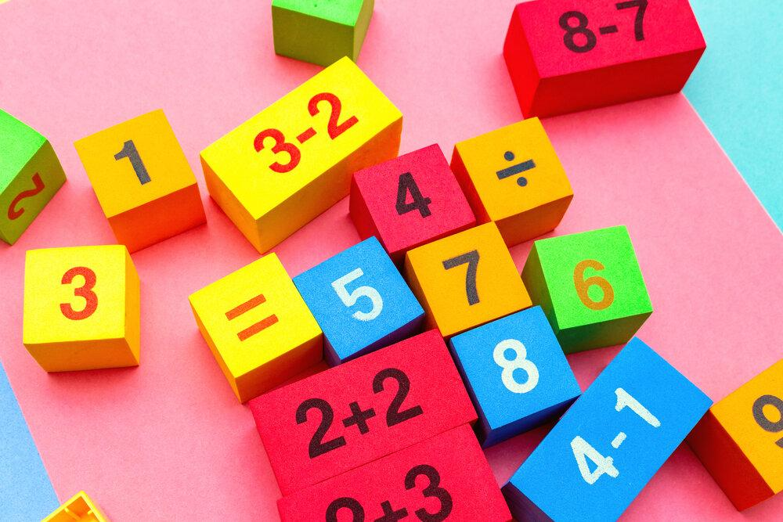
CONCLUSION
Eigenvalues and Eigenvectors are fundamental in data science and model-building in general. Besides their use in PCA, they are employed, namely, in spectral clustering and image compression. Eigenvalues and Eigenvector concepts are used in several fields including machine learning, quantum computing, communication system design, construction designs, electrical and mechanical engineering, etc. Hence, it is important to have clear in mind their geometrical interpretation.

Slide 29
BIBLIOGRAPHY
Linear Algebra and its applications, David C. lay, Steven R. lay, Judi J Mc. Donald, 5 Edition, 2015, Pearson Education. th
Linear Algebra and its applications, Gilbert Strang, 4 edition, 2005, Brooks Cole.
Linear Algebra an Introduction, Richard Bronson & Gabriel B. Costa, 2nd edition.

Slide 30


